Slide 1
Using Machine Learning Techniques to Improve Paint Adhesion
VISIT UW | IITGN

Slide 2

Contents
The Problem
Possible solutions and their feasibilty
Solution we choose

Slide 3
Contents
The Problem
Possible solutions and their feasibilty
Solution we choose

Slide 4
Problem Statement
To find the optimal value of parameters (number of passes, translating speed, stand-off distance) for plasma treatment of thermoset polymers (tetra-functional epoxy raisin) to increase paint adhesion on the polymer surface.

Slide 5
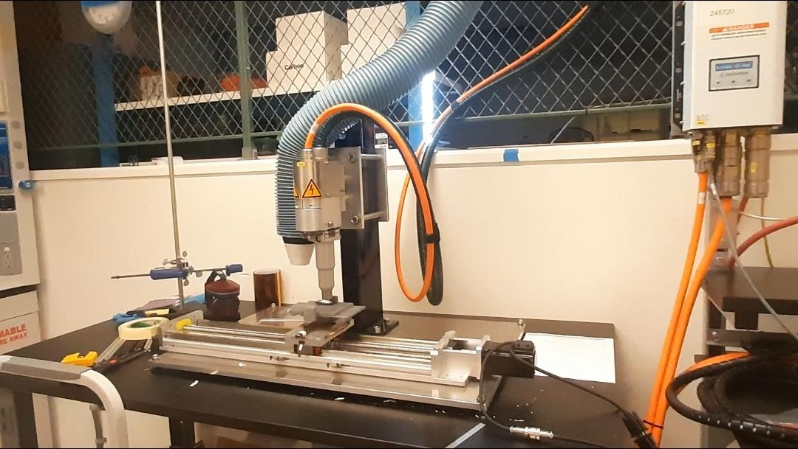
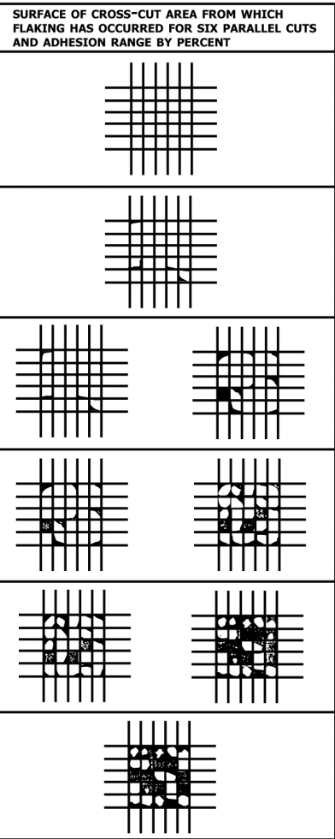

Plasma treatment and tape tests
Tape test image ready for analysis
Plasma Treatment Setup at MEBG042
Image: ASTM Tape Test Manual

Slide 6
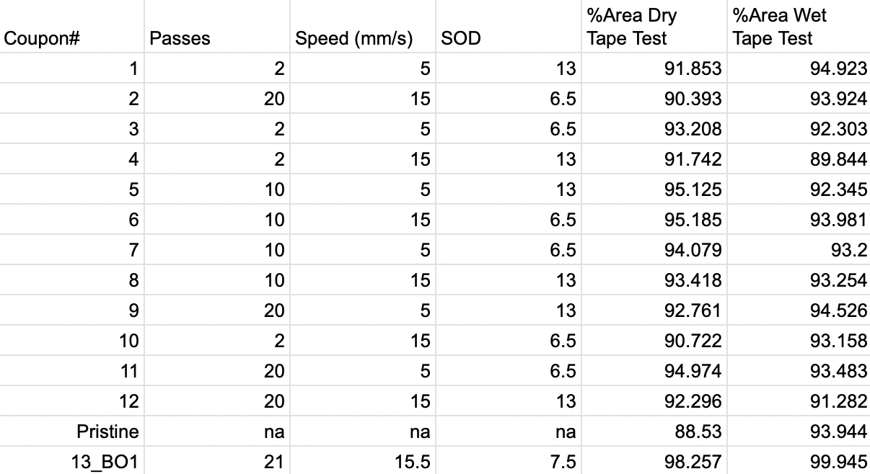
Inputs and outputs

Slide 7
Possible Solutions
Design of experiment and then model the input-output relationship
Machine Learning regression models
Solution we choose..stay tuned..on the next slide

Slide 8
Bayesian Optimization

Slide 9
When to use Bayesian Optimization?
Evaluation of the objective function is expensive
You do not have close form expression for objective function but can obtain observations (can be noisy) from experiments.
Does not have access to derivatives
Problem may/may not be convex (we do not know what the answer is??)

Slide 10
Assumptions and restrictions
We are dealing with maximisation. Maximisation of f(x) is same as minimisation of -f(x).
Objective is Lipschitz continuos i.e. it has bounded derivatives which can not grow too fast.
We are concerned with global optimization and not local optimization.

Slide 11
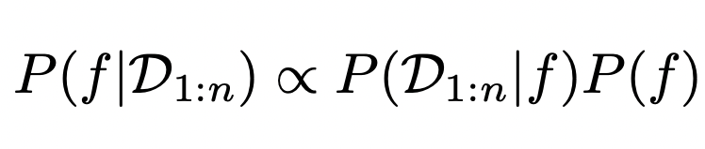
What is Bayesian Optimization?
“Technique of setting prior over the objective function and combining it with evidence to get posterior function”
[Brochu et. al, 2010]

Slide 12
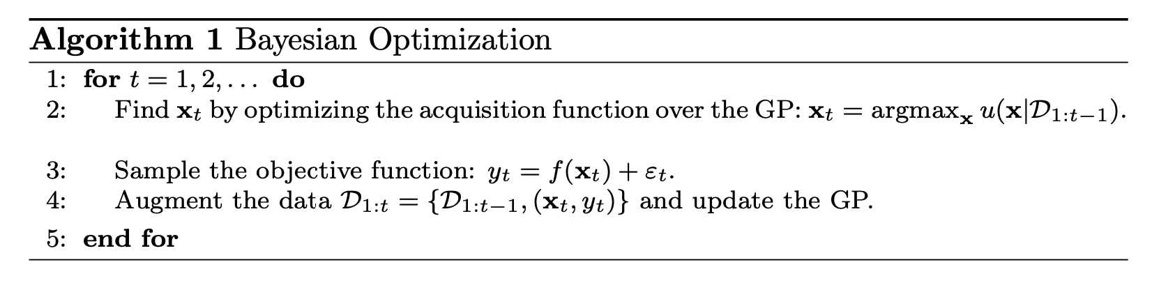
The BO Algorithm
Image Reference: A Tutorial on Bayesian Optimization of Expensive Cost Functions, with Application to Active User Modeling and Hierarchical Reinforcement Learning

Slide 13
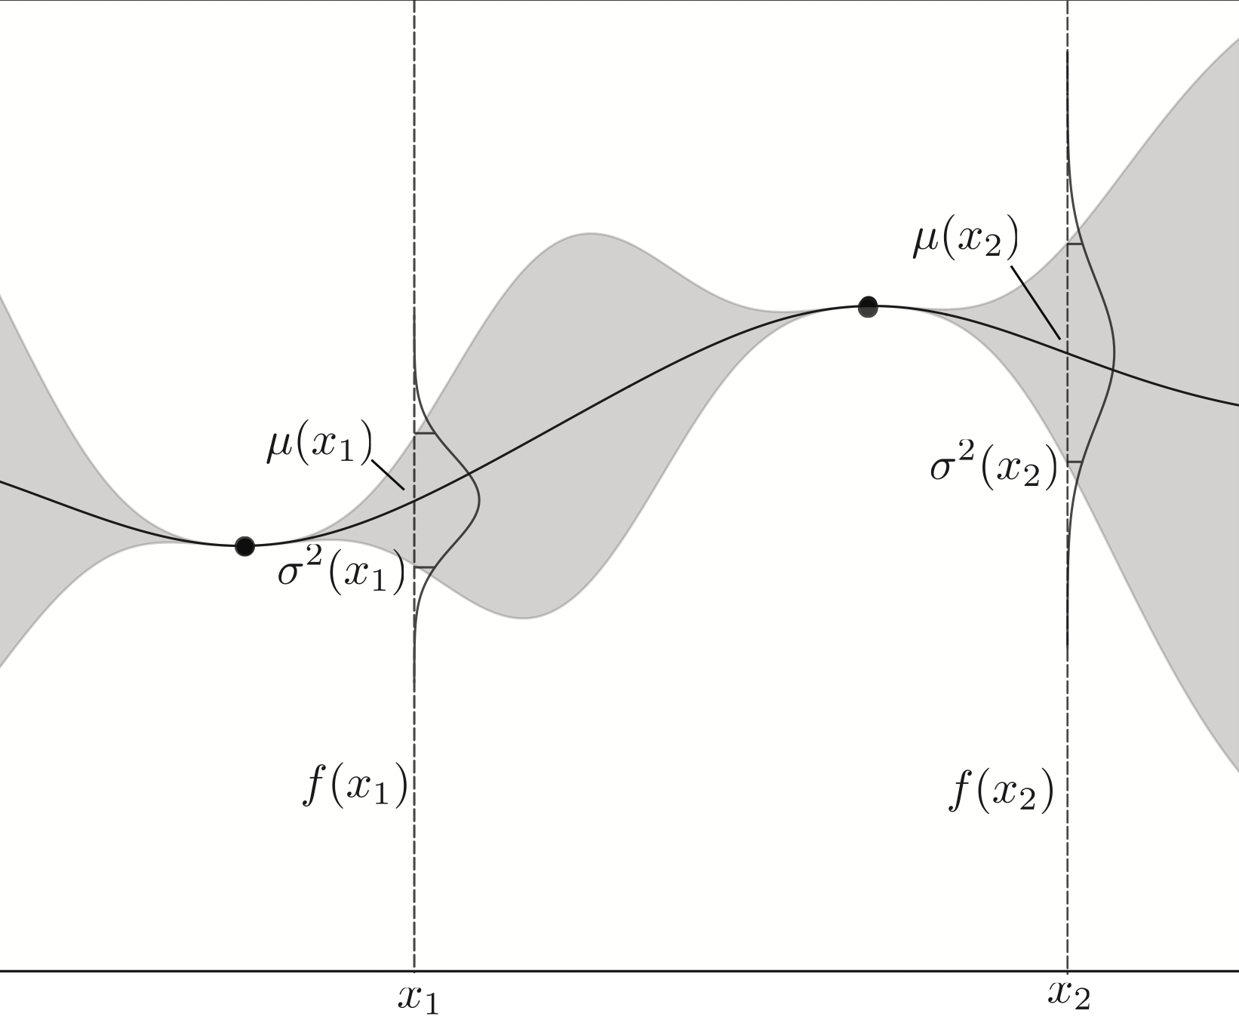
Placing prior
Gaussian Process are the most widely used surrogate models for placing prior.
[Mockus, 1994] showed that out of different prior distributions Gaussian Process is the best suited for the kind of optimisation tasks we have specified above.
Image reference: Tutorial on Bayesian Optimization

Slide 14
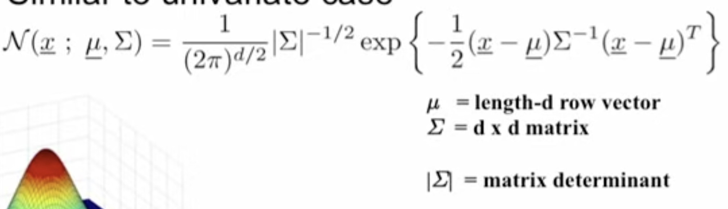
What are Gaussian Processes?
Image Reference: Alexander Ihler Slide
A GP can be understood as an extension of multivariate Gaussian Distribution to infinite dimension stochastic process. For this process, if you take any finite combination of dimensions it will follow Gaussian distribution [Rasmussen and Williams, 2006].

Slide 15
Combining with the evidence - Acquisition Functions
How do you update the prior and get the posterior?
Acquisition functions act as the guide that would lead you to optimum.
These are chosen such that a high value of acquisition would correspond to a potentially high value of the objective.

Slide 16
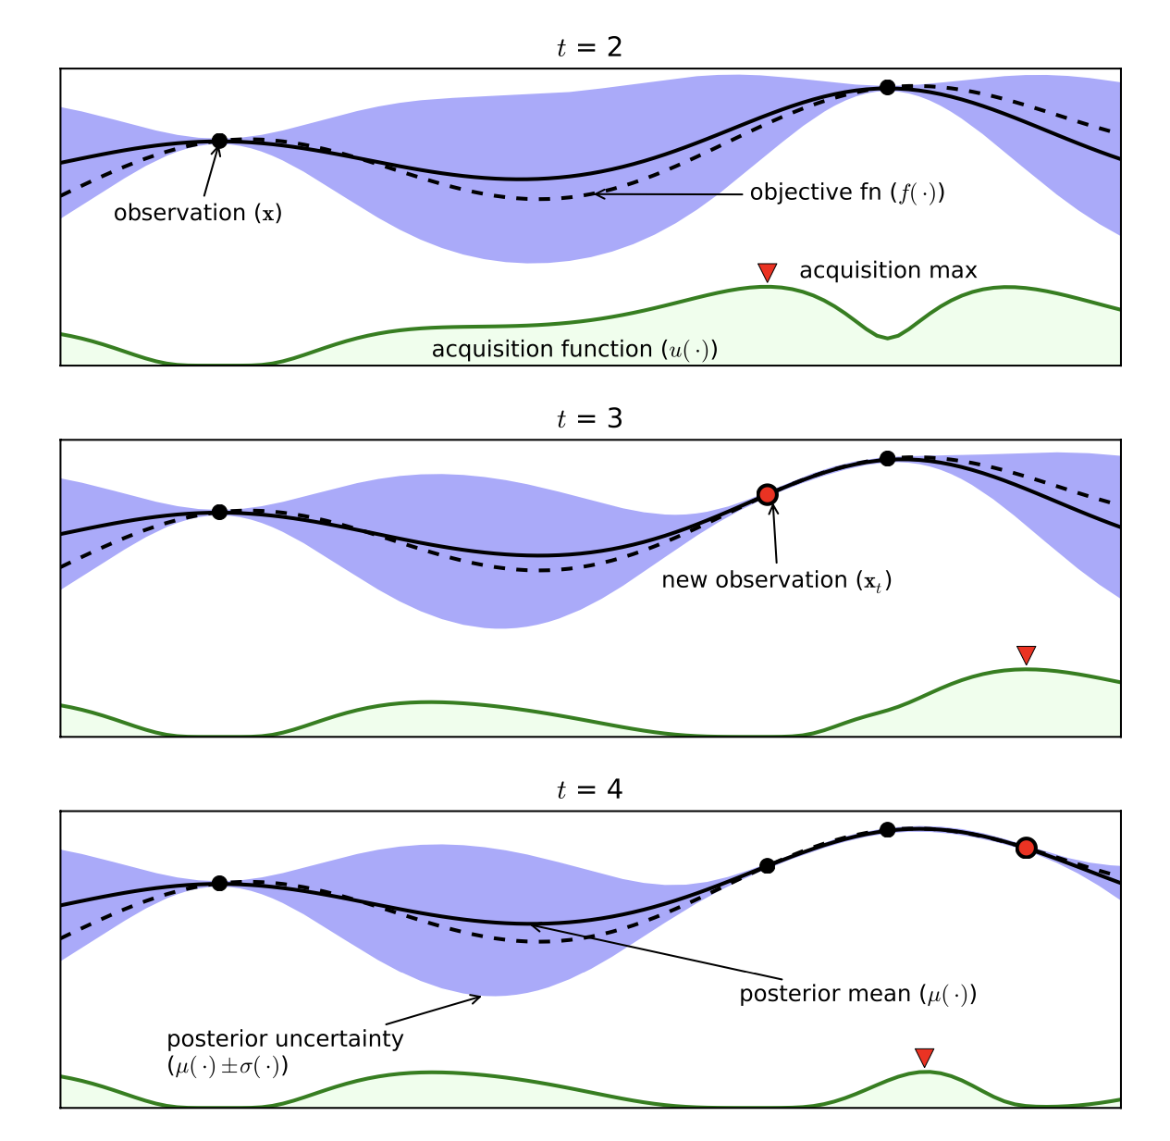
Combining with the evidence - Acquisition Functions
Image Reference: Course on BO at University of British Columbia

Slide 17
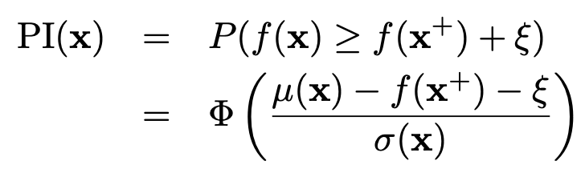
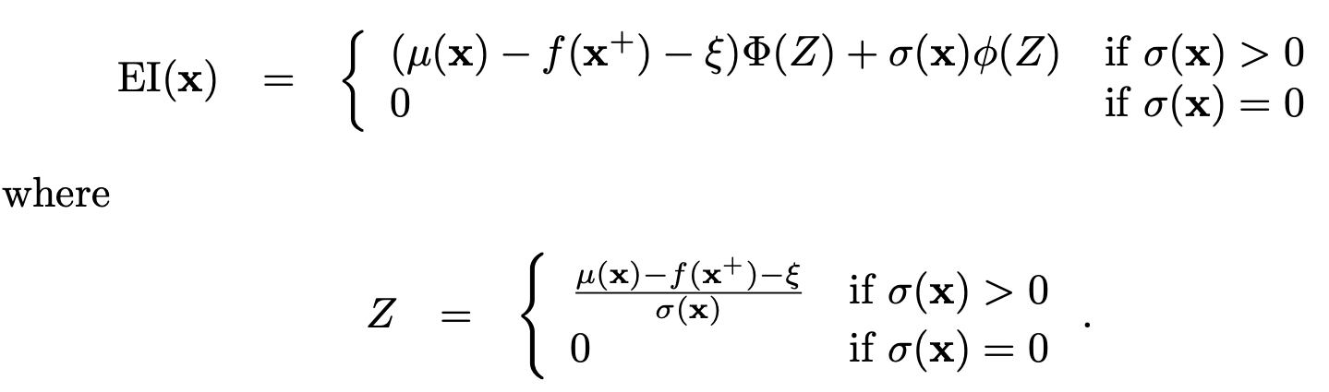
Standard Acquisition Functions
Improvement Based Acquisition
Probability of Improvement
Expected Improvement

Slide 18
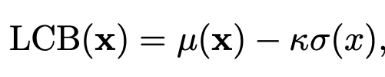
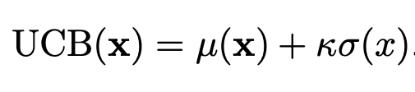
Standard Acquisition Functions
Confidence-bound criteria
Lower confidence bound
Upper confidence bound

Slide 19
Exploration-exploitation trade off
EI is the most widely used acquisition since it takes into account both whether the improvement is happening or not and the magnitude of improvement.
𝛇 is the parameter controlling the exploration exploitation trade-off.
[Kushner 1964] and [Kushner 1997] suggest that we should start with a high value for exploration and then follow a cooling schedule.
[Lizotte, 2008] suggested that value of 𝛇 = 0.01 works well for almost all the cases.

Slide 20
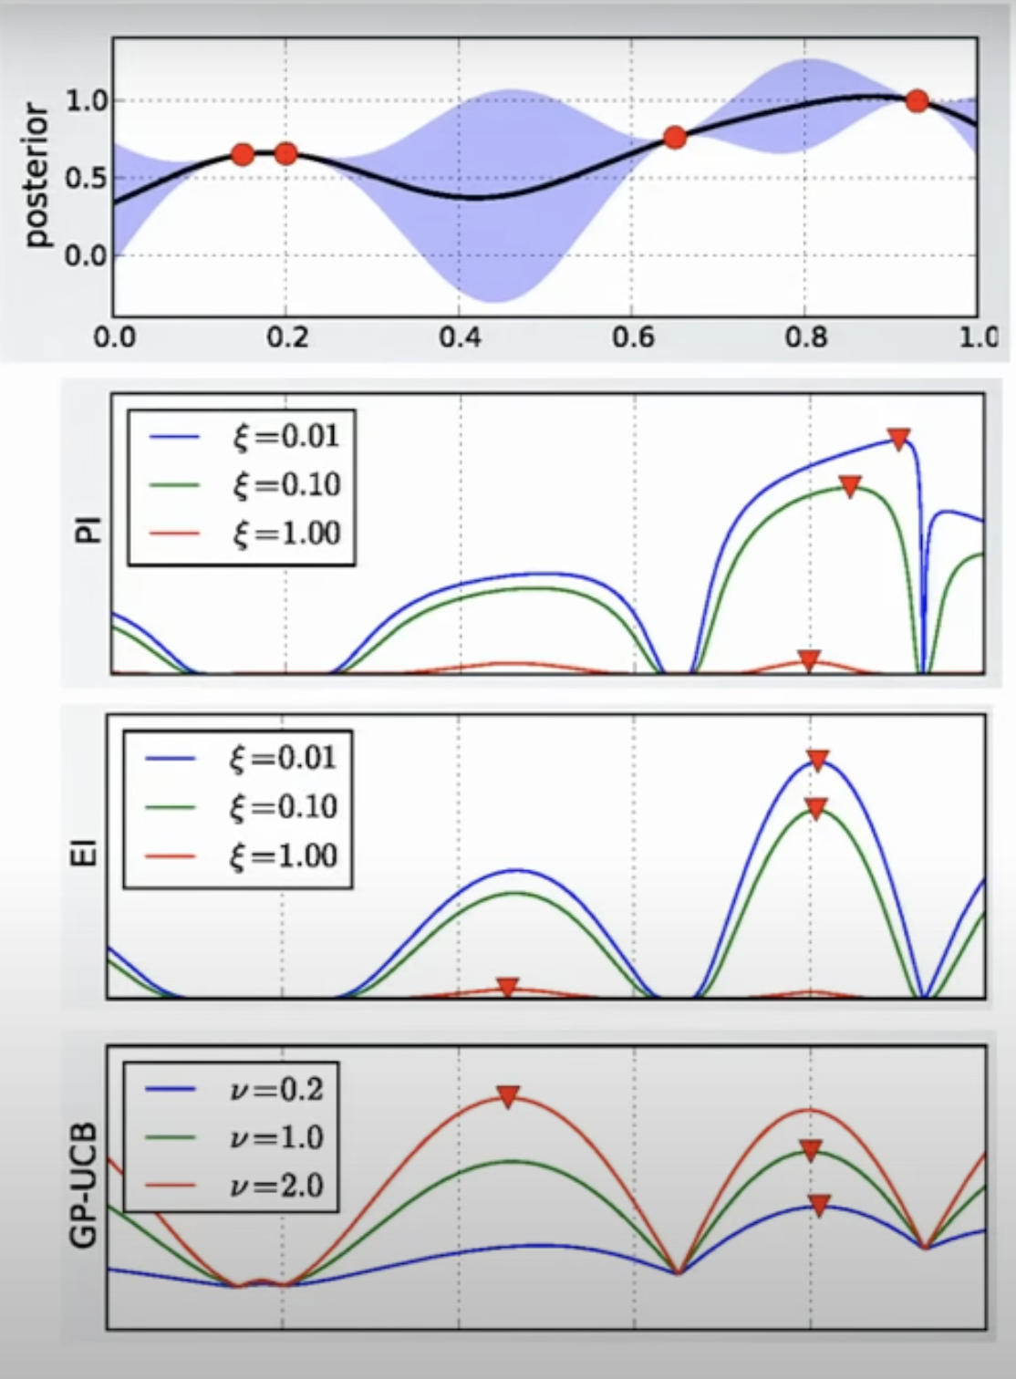
Exploration-exploitation trade off
Image Reference: Machine learning - Bayesian Optimization and Multi Armed Bandit

Slide 21
Application to our data
Numerous libraries are available that have the implementation of BO, some of them are DiceOptim, Spearmint, Emukit, BoTorch, GPyOpt.
We use GPyOpt for our application. It is an open source software developed at University of Sheffield.

Slide 22
Why GPyOpt?
Easy to use
Capabilty to mix different kind of variables
Support for widely used priors and standard acquisitions.
Allows us to append our own implementation of prior or acquisition if required
Based on GPy which is known to be a stable trusted GP library.
Allows for external objective evaluation.

Slide 23
First suggested points in the iteration
The bounded input space was defined in the slide above.
The next suggested point for the evaluation by the BO algorithm was:
Number of Passes = 21
Translational Speed (mm/s) = 15.5
SOD (mm) = 7.5

Slide 24
Results for the first suggested point

Slide 25
When to stop?
Multiple re-runs and restarts are done to avoid the stopping at a local optima.
We generally have a convergence criteria ~ something like 10-20% of the target.
[Li et al. 2017], proposed a new way for synthesis of short polymer fibers, with five input variables they ran the model for 20 iterations, five restarts.

Slide 26
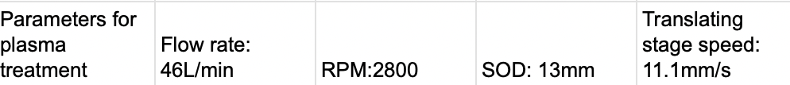
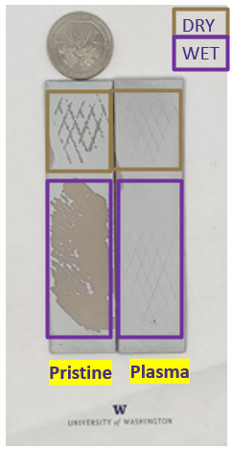
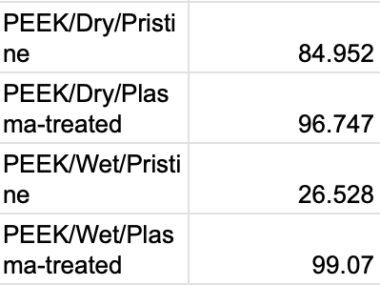
Next step : PEEK Results
After thermosets, tried studying the effect of plasma treatment on PEEK samples.

Slide 27
Acknowledgements
I want to thank Prof. Vashisth and Ankush Nandi for their guidance on the Project
Prof Kumar for all the support.
CDS IITGN and Department of Mechanical Engineering UW for giving me this research opportunity and funding the internship.

Slide 28
References
Frazier, P. I. (2018). A tutorial on Bayesian optimization. arXiv preprint arXiv:1807.02811.
Brochu, E., Cora, V. M., & De Freitas, N. (2010). A tutorial on Bayesian optimization of expensive cost functions, with application to active user modeling and hierarchical reinforcement learning. arXiv preprint arXiv:1012.2599.
Li, C., Rubín de Celis Leal, D., Rana, S. et al. Rapid Bayesian optimisation for synthesis of short polymer fiber materials. Sci Rep 7, 5683 (2017). https://doi.org/10.1038/s41598-017-05723-0
Zhang, M., Parnell, A., Brabazon, D., & Benavoli, A. (2021). Bayesian Optimisation for Sequential Experimental Design with Applications in Additive Manufacturing. arXiv preprint arXiv:2107.12809.
Williams, C. K., & Rasmussen, C. E. (2006). Gaussian processes for machine learning (Vol. 2, No. 3, p. 4). Cambridge, MA: MIT press.
Jones, D. R., Schonlau, M., & Welch, W. J. (1998). Efficient global optimization of expensive black-box functions. Journal of Global optimization, 13, 455-492.
Image courtesy on slide 2 : Barrick Gold Corporation

Slide 29
Thank you

Slide 30
Questions

